Slide 1
Introductory psychology (module 1)
Prof: Dr. Doe Buchli
Fall 2016
Mercer University

Slide 2
What is psychology?
What are the historical origins of psychology?
What are the major areas and/or subdivisions within the field of psychology today?

Slide 3
Psychology has Greek roots
Psyche == soul or mind
Logos == word or study

Slide 4
What is Psychology?
Psychology is the science of human behavior and mental processes.
Behavior is anything we do
overt actions and reactions
Mental processes are our internal experiences
thoughts, feelings, memories…
Notes:
Psychology is the science that studies behavior and the physiological and cognitive processes that underlie it.
It is a profession that applies the accumulated knowledge of this science to practical problems.

Slide 5
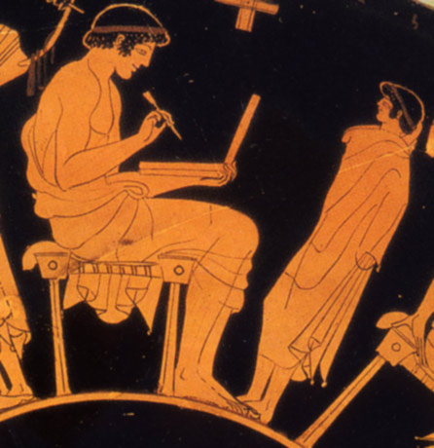
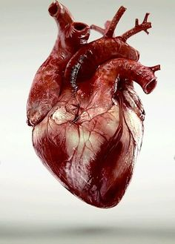

Notes:
Psychological questions have been asked since the dawn of civilization, beginning with armchair philosophers
Plato – memory is a wax tablet
Aristotle – the heart is the origin of personality and psychic energy; we get sleepy after meals because heat and gas form around the heart
Morton Hunt’s The Story of Psychology is a wonderful resource for teaching the history of psychology. This superbly written account includes separate chapters on Wilhelm Wundt, William James, and Sigmund Freud, as well as chapters on major schools such as behaviorism and Gestalt psychology.
Hunt opens his book with an account of history’s first recorded psychological experiment. In the seventh century B.C, Psamtick I, King of Egypt, wanted to prove the long-held belief that the Egyptians were the most ancient race on earth. He posed the hypothesis that if children had no opportunity to learn a language from the people around them, they would spontaneously speak the primal, inborn language of humankind, that is, the natural language of its most ancient people, which Psamtick presumed to be Egyptian.
To test his hypothesis, Psamtick kidnapped two infants of a lower-class mother and ordered a herdsman in a remote area to raise them. The children were to be properly fed and cared for but were never to hear anyone speak a word. The experiment worked, although not with the result expected by Psamtick.
One day, when the children were just 2 years old, they ran up to the herdsman as he returned to his cottage from work and cried out “Becos!” Although he did not understand them, when they continued to repeat the word, he reported back to the king. The children were brought to the royal court. When the king also heard them say “Becos,” he inquired and learned that becos was the Phrygian word for bread. To his great disappointment, the king concluded that the Phrygians were an older race than the Egyptians.

Slide 6
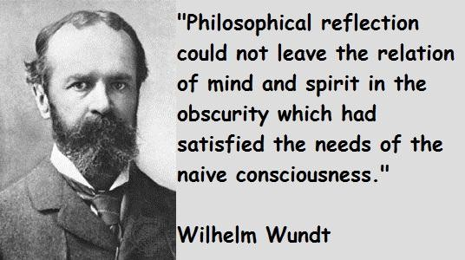
Notes:
Wilhelm Wundt
Thought philosophers could only go so far, established first psychological laboratory at the University of Leipzig in 1879

Slide 7
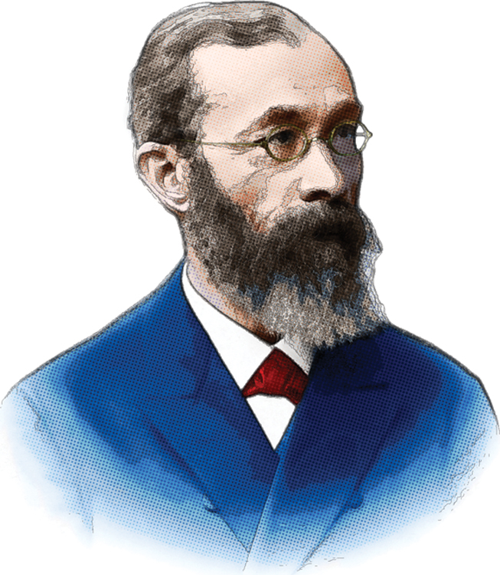
Wilhelm Wundt
First researcher to call himself a “psychologist”
Ran experiments in the first psychology lab beginning in 1879
Interested in measuring the “atoms of the mind”
Meaning the simplest and fastest mental processes
Notes:
Wundt wanted to distill the mind down to its most basic elements or structures
Establish fundamental relations or structures that could be used to explain all behavior
He was interested in “Introspection”

Slide 8

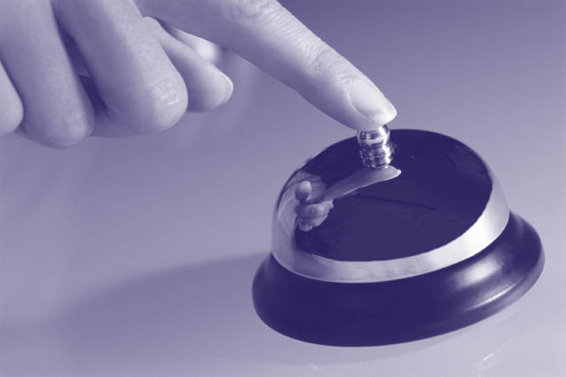
Wilhelm Wundt’s 1879 experiment measured the time it took for people to:
Push a button when a ball dropped (based on when they heard the ball hit a platform): 1/10th of a second.
Push a button when consciously aware of hearing the ball hit the platform: 2/10ths of a second.
Why were the times different?
Notes:
People were asked to listen to a ball hit a platform and then hit telegraph key as quickly as possible.
Either: once they heard it or they had a conscious awareness that they heard it
Interested in consciousness
Took 1/10 of a second when pressing the key after hearing ball hit the platform
Took 2/10 of a second when pressing after consciously aware of hearing it

Slide 9
Wundt was first to distinguish between
Sensation: a stimulus effect on our senses
Perception: our brain’s interpretation of the stimulus

Slide 10
Two main “Schools of Thought”
Structuralism
Functionalism
late 19th early 20th century
Notes:
Then psychology was organized into two parts: Structuralism and functionalism

Slide 11
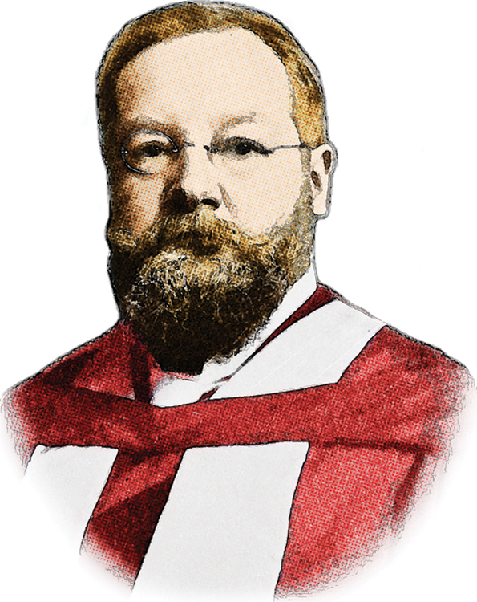
Structuralism
Goal: To break apart the mind into its simplest components to understand how our mind works.
Used the method of introspection
Participants observe and report their own mental states and processes
Associated with Edward Titchener
Notes:
Introspection (looking inward): training them to report elements of their experience as they looked at a rose, listened to a metronome, smelled a scent, or tasted a substance. What were their immediate sensations, their images, their feelings? And how did these relate to one another

Slide 12
Question What are some potential problems with this approach?
Notes:
Need smart, verbal people
Results and experiences varied from person to person
Our own interpretations of events and experiences are often wrong/inaccurate

Slide 13
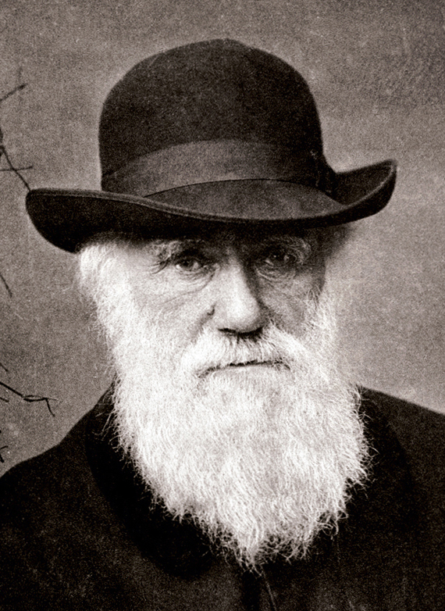
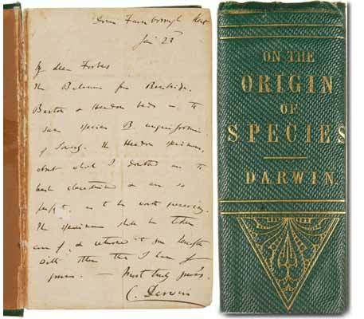
Notes:
Charles Darwin

Slide 14
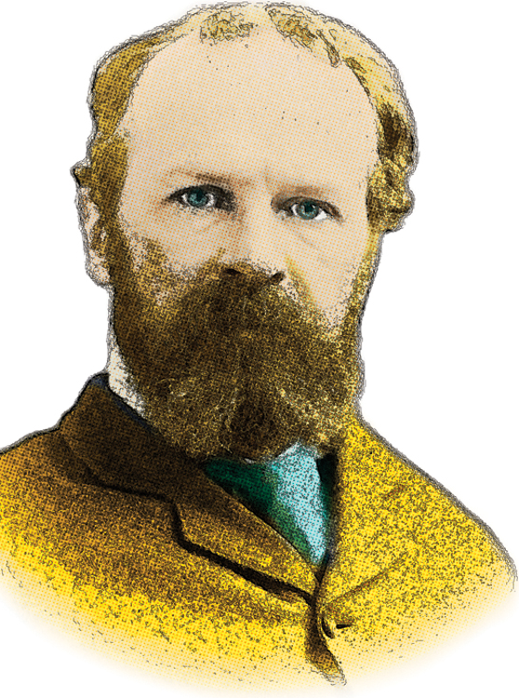
Functionalism
Goal: To discover what the purpose of this adaptation is in evolutionary history
Studied thoughts, feelings, and behaviors, then asked the following questions:
What function does it serve?
How did it help our ancestors survive?
Associated with William James
Notes:
They thought it was not enough to just break the mind up. We have to understand why do different parts of our mind and body do different things. And how does this relate to evolution.
Explorations of down-to-earth emotions, memories, willpower, habits and moment-to-moment streams of consciousness.

Slide 15
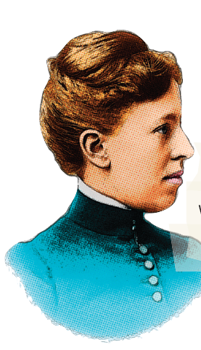
Psychology Pioneers
Mary Whiton Calkins (1863-1930) became a memory researcher and the first female president of the APA.
She studied with William James but was denied a Harvard PhD.
Mary Whiton Calkins
Notes:
Calkins studied with William James but was denied a Harvard PhD because of her gender. She then declined a degree offered by Radcliffe College. She taught at Wellesley College from 1891 to 1929.
APA = American Psychological Association. The “experimental psychology organization” was similar in mission to today’s Association for Psychological Science.

Slide 16
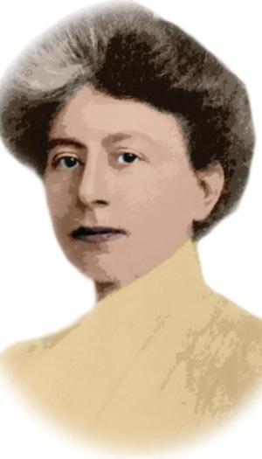
Psychology Pioneers
Margaret Floy Washburn (1871-1939), PhD, became the second female APA president, and wrote The Animal Mind.
She studied with Edward Titchener, but was barred from his experimental psychology organization because of gender
Margaret Floy Washburn, PhD

Slide 17
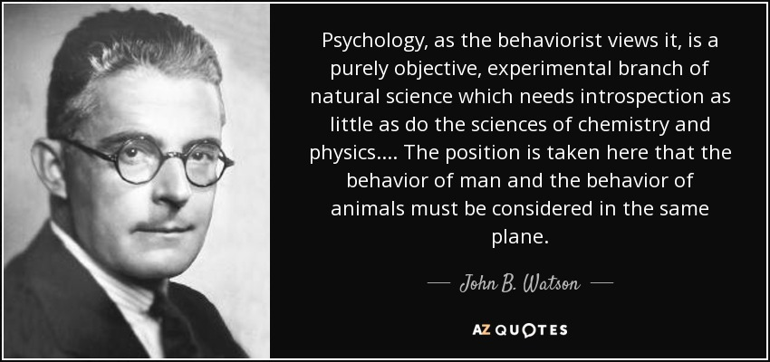

Slide 18
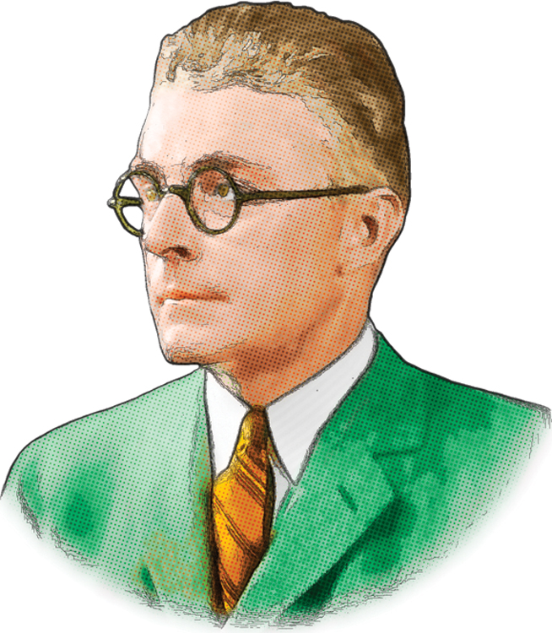
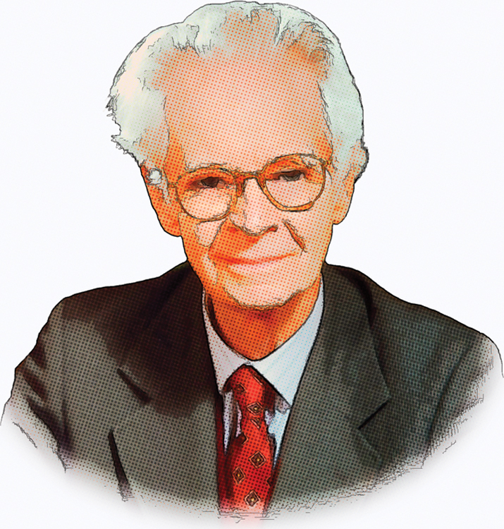
Behaviorist Perspective
Predominant school of thought in American psychology from 1920s to 1960s
Redefined psychology as the scientific study of observable behavior
Rejected introspection
Not interested in thoughts or internal mental states and processes
Associated with John Watson and B.F. Skinner
Notes:
Reaction to introspection

Slide 19
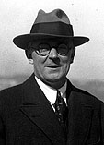
“Give me a dozen healthy infants, well-formed and my own special world to bring them up in and I’ll guarantee to take any one at random and train him to be any type of specialist I might select – a doctor, a lawyer, artist…” -Watson 1924

Slide 20
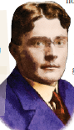
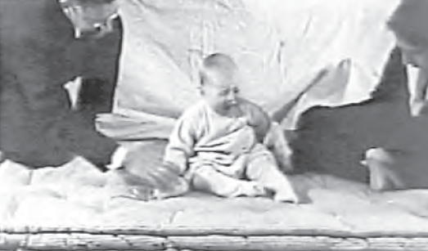
Little Albert Experiment
In 1920, 9-month-old Little Albert was not afraid of rats.
John B. Watson and Rosalie Rayner then clanged a steel bar every time a rat was presented to Albert.
Albert acquired a fear of rats, and generalized this fear to other soft and furry things.
Watson prided himself in his ability to shape people’s emotions. He later went into advertising.
Notes:
A different application of classical conditioning would include working with phobias; not just creating them, but eliminating them.
Exposure to a conditioned stimulus (such as a store where panic attacks have occurred) without UR (the panic attack) can extinguish phobias, but to prevent spontaneous recovery, counter-conditioning must occur (associating the store with a relaxed state).

Slide 21
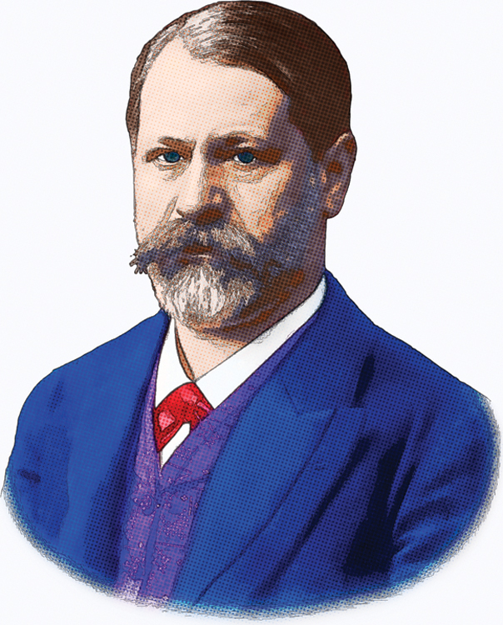
Psychoanalytic Perspective
Active in early 20th century
Developed psychoanalysis, in which therapists work with patients to bring unconscious conflicts into the patient’s conscious awareness
Was very influential, but most of his theories were difficult to study scientifically and are no longer widely accepted
However, his idea that mental processes can occur without conscious awareness is now accepted in mainstream psychology
Sigmund Freud
Notes:
Emphasized the ways our unconscious thought processes and our emotional responses to childhood experiences affect our behavior

Slide 22
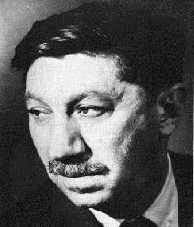
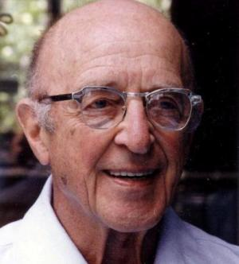
Humanist Perspective
Abraham Maslow
Carl Rogers
Studied successful individuals’ traits to generalize so the wider population can apply

Slide 23
PSYCHOLOGY AS IT EXISTS TODAY

Slide 24
What is psychology?
“Study of the mind”
“Study of mental behavior and actions”
“Study of what influences our everyday actions and decisions”
“How people perceive things through social, personal, and emotional experiences”
“Why we act the way we do”
44% agreed with the statement, “Psychology is largely the study of atypical behaviors and mental disorders”
Notes:
BALL:
What is this?... Is that psychology?
Protons absorbed by the cones and rods in your retina, information travels through the optic nerve to the primary visual cortex where information is processed from a 2D image to a 3D one, recognizing borders, parsing out objects from the backgrounds; this is then compared to the things you’ve encountered, to things in your memory to tell you, “this is a ball, backpack or eggplant”.
Perception is in the mind…. Certain subgroups of patients would have trouble naming this object, but might for example, know to bounce it. Others might be able to name it but be unable to tell you what it is for.
Occlude part of SECOND ball: What is this? How do you know?
Behind back: What’s there? Babies and HC damage patients. MEMORY
Point at a volunteer: Would you mind standing up for me? Now sit down. OBEDIENCE. Why do we obey? When do we obey? And how far would we go?
Okay, now stand up. No? That’s LEARNING. No really, I would really love if you would stand up for this next part. PERSUASION.
People are chuckling. HUMOR. Why do we have humor? Why do we laugh? Why does it feel good to laugh with others? Maybe you’re feeling some kind of EMOTION right now. What are emotions, how do we identify them, what purpose do they serve?
Throw ball. How did you do that?
MOTOR
Incredibly complex thing that you did just now. ….expand; baseball
Now, what if instead of a ball, this had been a scorpion. What would you have done?
Who here enjoys sports? Why do some teams crack under pressure whilst others thrive? Why do people care about teams that they are affiliated, and even teams that they are not affiliated with (UCLA vs USC, in LA for instance)
Honestly, I know nothing and almost care nothing for sports. Why are there individual differences in preferences, attitudes, and behaviors?
How do we make decisions? Why are you in this class? Why do we give, why do we love? Why do people like watching the train wrecks on reality TV?
What are the legal, medical and educational implications of what we know about human nature?
The scientific method; intuitions are often wrong
Useful for assessing any information that you receive, even if you do not ultimately pursue science

Slide 25
Basic vs. Applied Research
Basic Research
Research that attempts to increase scientific knowledge in general
Explores fundamental bases of behavior
Applied Research:
Research that addresses practical, real-world problems

Slide 26
What does psychology today encompass?
Basic Research Areas
Biological
Cognitive
Developmental
Social
Personality
Notes:
To a large extent, these divisions are arbitrary
Research that attempts to increase scientific knowledge in general
Explores fundamental bases of behavior

Slide 27
Biological Psychology
Studies the relationship between psychological processes and the body’s physical systems such as the brain, nervous system, endocrine system, immune system and genetics

Slide 28
Cognitive Psychology
Investigates mental processes including reasoning, thinking, problem solving, memory, perception, mental imagery and language

Slide 29
Developmental Psychology
Studies the physical, social, and psychological changes that occur at different ages and stages in the lifespan, from birth to old age

Slide 30
Social Psychology
Explores how people are affected by their social environments, including how people think about and influence others

Slide 31
Personality Psychology
Personality refers to individual differences in characteristic patterns of thinking, feeling and behaving.
The study of personality focuses on two broad areas: One is understanding individual differences in particular personality characteristics, such as sociability or irritability. The other is understanding how the various parts of a person come together as a whole.
Adapted from the Encyclopedia of Psychology

Slide 32
Psychology’s Subfields
Type of research
Biological
Explore the structural problems in the brain that may be part of autism
Developmental
Study how the stages of cognitive and emotional development vary in autism
Cognitive
Clarify the difficulties autistic children have with understanding sarcasm
Personality
Decide whether traits like neuroticism need to be measured differently in autism
Social
Find how autistic children can learn social skills as procedures if not by intuition
Positive Psychology
Explore what motivates people and contributes to life satisfaction

Slide 33
What does psychology today encompass?
Applied Psychology
Clinical
Health
Industrial/Organizational
Educational
Forensic
Sports
Notes:
Research that addresses practical, real-world problems
CLINICAL
Studies the causes, diagnosis, treatment, and prevention of different types of behavioral and emotional disorders
Counseling psychologists: assist people with challenges in their daily lives, especially in interpersonal relationships
Clinical psychologists: assess and treat psychological disorders, usually through some form of psychotherapy
Psychiatrists: medical doctors who treat psychological disorders, usually through a combination of psychotherapy and medication
Survey: 41% had said that Psychology is largely the study of atypical behaviors and mental disorders

Slide 34
Clinical Psychology
Studies the causes, diagnosis, treatment, and prevention of different types of behavioral and emotional disorders
Counseling psychologists: assist people with challenges in their daily lives, especially in interpersonal relationships
Clinical psychologists: assess and treat psychological disorders, usually through some form of psychotherapy
Psychiatrists: medical doctors who treat psychological disorders, usually through a combination of psychotherapy and medication

Slide 35
Health Psychology
The study of psychological and behavioral processes in health, illness, and healthcare. It is concerned with understanding how psychological, behavioral, and cultural factors contribute to physical health and illness.

Slide 36
Industrial/Organizational Psychology
I/O psychologists study human behavior in the workplace; they apply psychological theories and principles to organizations, often with an emphasis on improving productivity and enhancing employees’ well-being.

Slide 37
Educational Psychology
Educational psychologists work with children in an educational setting; they are concerned with teaching and learning methods, cognitive development and aptitude assessment.

Slide 38
Forensic Psychology
Forensic psychology is the interaction of the practice or study of psychology and the law. Psychologists interested in this line of applied work may be found working in prisons, jails, rehabilitation centers, police departments, law firms, schools, government agencies, or in private practice, to name a few.

Slide 39
Sports Psychology
Sports psychology is the study of how psychology influences sports, athletic performance, exercise, and physical activity. Some sports psychologists work with professional athletes and coaches to improve performance and increase motivation. Other professionals utilize exercise and sports to enhance people’s lives and well-being throughout the entire lifespan. Sports psychologists may also work with rehab doctors and physical therapists to assist athletes recovering from injuries.

Slide 40
Psychology’s Subfields
Applied
Clinical Psychology
Use exposure therapy to decrease phobic reactions in a traumatized client
Counseling Psychology
Help someone achieve career goals despite family conflict and self-doubt
Educational Psychology
Evaluate aptitudes and achievement to plan for a student with learning problems
Industrial-Organizational
Figure out how a factory can improve coordination of tasks, roles, and personalities
Notes:
Click to reveal an example of each type of applied psychology.
Instructor: This slide lists categories that are covered in more depth in the next two slides.

Slide 41
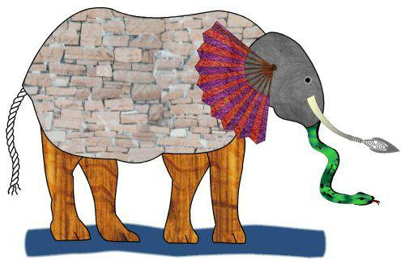
Different perspectives on a single issue: Six Blind Men and an Elephant
Notes:
The image refers to the “Six Blind Men and the Elephant,” a poem by John Saxe (1816-1887) based on an ancient Indian folktale. The parable illustrates how people with limited perspective can be mistaken if they feel they have the whole picture, seeing the elephant as a rope, wall, tree trunk, fan, spear and snake.
Image (c) Jason Hunt naturalchild.org/jason

Slide 42
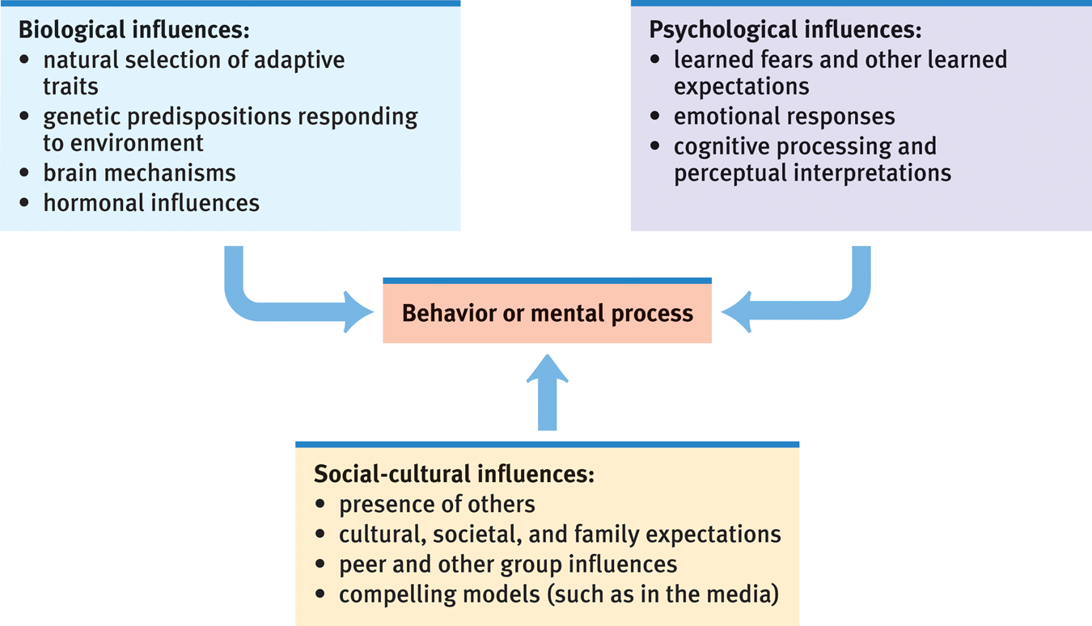
The three levels as influences on some psychological phenomenon
Example: Depression
Example: Enjoying Soccer
Example: Intelligence
Example: Shyness

Slide 43
There are many perspectives for describing psychological phenomena:
From different angles, you ask different questions:
Cognitive perspective
Social-cultural
Behavioral genetics
Neuroscience
Psychodynamic
Behaviorist
Evolutionary
How reliable is memory? How can we improve our thinking?
Could our behavior, skills, and attitudes be “downloads” from our culture?
Could our behavior, skills, and attitudes be genetically programmed instincts?
What role do our bodies and brains play in emotions? How is pain inhibited? Can we trust our senses?
Do inner childhood conflicts still plague me and affect my behavior?
How are our problematic behaviors reinforced? How do our fears become conditioned? What can we do to change these fears and behaviors?
Why are humans prone to panic, anger, and making irrational judgments?

Slide 44
Let’s play: “What’s my perspective?”
“Obsessive-compulsive disorder is a problem in the orbital cortex.”
Neuroscience
“Compulsions start as habits and are rewarded by the anxiety relief they bring.”
Behaviourist
“No, it’s a sign of unresolved childhood issues.”
Psychodynamic
“OCD comes from our natural instinct to control our environment.”
Evolutionary
“No, OCD is an inherited condition.”
Behavioural genetics
“OCD thinking and behavior is a reaction to our fast-paced, out-of-control lifestyles.”
Social Cultural
“No, OCD is a matter of mental habits and errors that can be corrected.”
Cognitive perspective

